Slide 1
New Perspectives on Microsoft Excel 2019

Slide 2
Analyzing and Charting Financial Data
Module 4

Slide 3
Objectives, Part 1
Create a pie chart
Format chart elements
Create a line chart
Work with chart legends
Create a combination chart

Slide 4
Objectives, Part 2
Create a scatter chart
Edit a chart data source
Create a data callout
Insert shapes and icons into a worksheet
Create and edit a data bar
Create and edit a group of sparklines

Slide 5
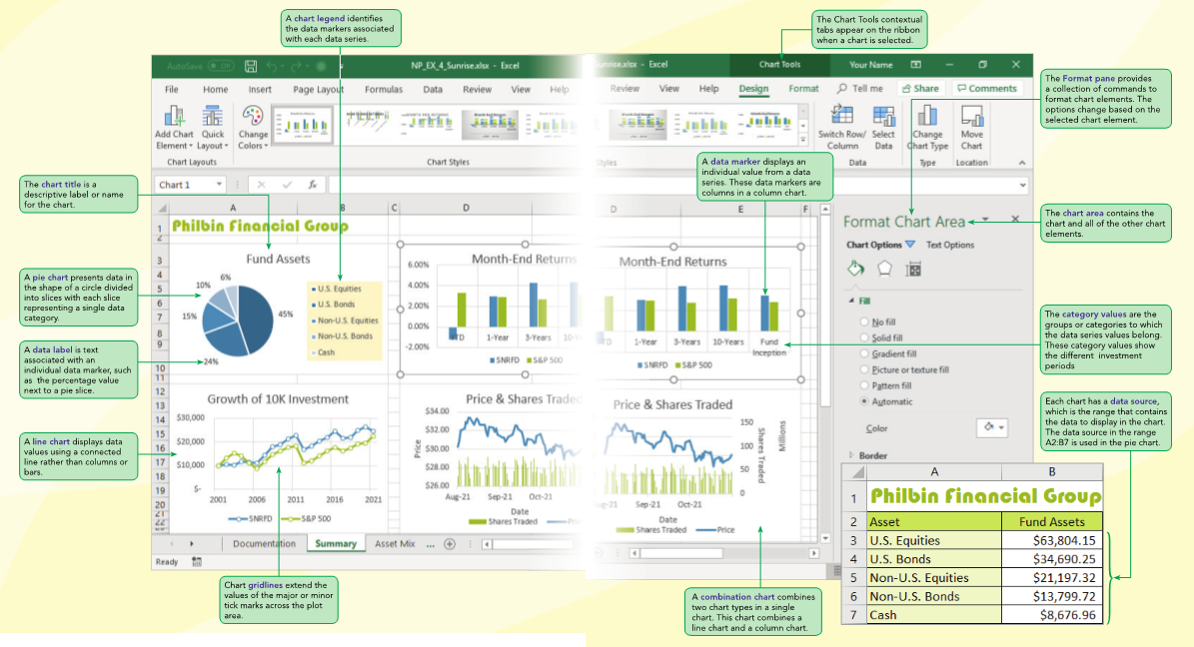
Visual Overview: Chart Elements

Slide 6
Getting Started with Excel Charts, Part 1
Charts show trends or relationships in data that are easier to see in a graphic representation rather than viewing the actual numbers or data
Excel has more than 60 types of charts organized into the 10 categories described in Figure 4–1
Within each chart category are chart variations called chart subtypes
You can also design custom chart types to meet your specific needs

Slide 7
Getting Started with Excel Charts, Part 2
Creating a Chart
Select the range containing the data you want to chart
On the Insert tab, in the Charts group, click the Recommended Charts button or a button representing the general chart type, and then click the chart you want to create; or click the Quick Analysis button, click the Charts category, and then click the chart you want to create
On the Chart Tools Design tab, in the Location group, click the Move Chart button, select whether to embed the chart in a worksheet or place it in a chart sheet, and then click OK
Use the chart tools to format the appearance of individual chart elements

Slide 8
Getting Started with Excel Charts, Part 3: Figure 4-1 Excel chart types and subtypes
Chart Category | Description | Chart Subtypes
Column or Bar | Compares values from different categories. Values are indicated by the height of the columns or the length of a bar. | 2-D Column, 3-D Column, 2-D Bar, 3-D Bar
Hierarchy | Display data that is organized into a hierarchy of categories where the size of the groups is based on a number. | Treemap, Sunburst
Waterfall or Stock | Displays financial cash flow values or stock market data. | Waterfall, Funnel, Stock
Line or Area | Compares values from different categories. Values are indicated by the height of the lines. Often used to show trends and changes over time. | 2-D Line, 3-D Line, 2-D Area, 3-D Area
Statistic | Displays a chart summarizing the distribution of values from a sample population. | Histogram, Pareto, Box and Whisker

Slide 9
Getting Started with Excel Charts, Part 4: Figure 4-1 Excel chart types and subtypes
Chart Category | Description | Chart Subtypes
Pie | Compares relative values of different categories to the whole. Values are indicated by the areas of the pie slices. | 2-D Pie, 3-D Pie, Doughnut
X Y (Scatter) or Bubble | Shows the patterns or relationship between two or more sets of values. Often used in scientific studies and statistical analyses. | Scatter, Bubble
Surface or Radar | Compares three sets of values in a three-dimensional chart. | Surface, Radar
Combo | Combines two or more chart types to make the data easy to visualize, especially when the data is widely varied. | Clustered Column-Line, Clustered Column-Line on Secondary Axis, Stacked Area-Clustered Column
Map | Compares data values across geographical regions. | Filled Map
PivotChart | Creates a chart summarizing data from a PivotTable. | PivotChart, PivotChart & PivotTable

Slide 10
Creating a Pie Chart, Part 1
Exploring Chart Types and Subtypes
A pie chart is a chart in the shape of a circle divided into slices like a pie
Each slice represents a single value from a data series
Larger data values are represented with bigger pie slices
The relative sizes of the slices let you visually compare the data values and see how much each contributes to the whole
Pie charts are most effective with six or fewer slices, and when each slice is large enough to view easily

Slide 11
Creating a Pie Chart, Part 2
The data displayed in a chart come from a data source, which includes one or more data series and a set of category values
The data series is the actual values that are plotted on the chart
The Charts category in the Quick Analysis tool displays chart types that are appropriate for the selected data source

Slide 12
Creating a Pie Chart, Part 3
Inserting a Pie Chart with the Quick Analysis Tool
After you select an adjacent range to use as a chart’s data source, the Quick Analysis tool appears
The Quick Analysis tool includes a category for creating charts
The Charts category lists recommended chart types—the charts that are most appropriate for the data source you selected

Slide 13
Creating a Pie Chart, Part 4
Moving and Resizing Charts
Excel charts are either placed in their own chart sheets or embedded in a worksheet
When you create a chart, it is embedded in the worksheet that contains the data source
Selecting the chart displays:
A selection box (used to move or resize the chart)
Sizing handles (used to change the chart’s width and height)

Slide 14
Creating a Pie Chart, Part 5
Pie slices do not need to be fixed within the pie
An exploded pie chart moves one slice away from the others as if someone were taking the piece away from the pie
Exploded pie charts are useful for emphasizing one category above the others

Slide 15
Creating a Pie Chart, Part 6

Slide 16
Working with Chart Elements, Part 1
Every chart contains elements that can be formatted, added to the chart, or removed from the chart
The Chart Elements button is used to add, remove, and format individual elements
When you add or remove a chart element, the other elements resize to fit in the space
Live Preview shows how changing an element will affect the chart’s appearance

Slide 17
Working with Chart Elements, Part 2

Slide 18
Working with Chart Elements, Part 3
Formatting a Chart Element
Each element listed in the Chart Elements button contains a submenu of common formatting choices, such as the placement of data labels relative to the position of the data marker or pie slice
One way of modifying the chart layout is to choose a predefined layout from the Quick Layout button on the Chart Tools Design tab

Slide 19
Working with Chart Elements, Part 4
Choosing a Chart Style
When you create a chart, the chart is formatted with a style (a collection of formats)
In the pie chart created, the format of the chart title, the location of the legend, and the colors of the pie slices are all part of the default style
You can quickly change the appearance of a chart by selecting a different style from the Chart Styles gallery
Live Preview shows how a chart style will affect the chart

Slide 20
Working with Chart Elements, Part 5
Changing the Color Scheme
A pie slice is an example of a data marker that represents a single data value from a data series
You can format the appearance of individual data markers to make them stand out from the others
Pie slice colors should be as distinct as possible to avoid confusion
Depending on the printer quality or the monitor resolution, it might be difficult to distinguish between similarly colored slices or data

Slide 21
Performing What-If Analyses with Charts, Part 1
A chart is linked to its data source
Changes made to the data source affect the chart; a visual representation of changes
Makes charts a powerful tool for data exploration and what-if analysis

Slide 22
Performing What-If Analyses with Charts, Part 2
Another type of what-if analysis is to limit the data to a subset of the original values in a process called filtering
Rather than creating a new chart, you can filter an existing chart to only show specific data

Slide 23
Performing What-If Analyses with Charts, Part 3

Slide 24
Creating a Column Chart, Part 1
Column chart
Displays values in different categories as columns
Height of each column is based on its value
Bar chart
Column chart turned on its side
Length of each bar is based on its value
Better to use column and bar charts than pie charts when the number of categories is large or the data values are close in value

Slide 25
Creating a Column Chart, Part 2
Better to use column and bar charts than pie charts when the:
Number of categories is large
Data values are close in value
Easier to compare height or length than area
Column charts can include several data series
Comparing Column Chart Subtypes
Column and bar charts can display multiple data series
You can plot three data series against one category

Slide 26
Creating a Column Chart, Part 3
Comparing Column Chart Subtypes
The clustered column chart displays the data series in separate columns side-by-side so that you can compare the relative heights of the columns The stacked column chart places the data series values within combined columns showing how much is contributed by each series
The 100% stacked column chart makes the same comparison as the stacked column chart except that the stacked sections are expressed as percentages

Slide 27
Creating a Column Chart, Part 4
Creating a Clustered Column Chart
Select data source
Select type of chart to create
Move and resize the chart
Change chart’s design, layout, and format by:
Selecting one of the chart styles, or
Formatting individual chart elements

Slide 28
Creating a Column Chart, Part 5
Editing a Chart Title
A the top of the column chart, click Chart Title
Type the new title and press ENTER
Setting the Gap Width
Excel automatically sets the space between the data series in a column chart as well as the gap width between one category value and the next
You can modify the space between the data series and gap width using the Format pane

Slide 29
Creating a Column Chart, Part 6
Adding Gridlines to a Chart
A gridline is a line that extends from the chart’s horizontal and vertical axis into the plot area, making it easier to identify the values or categories associated with the chart’s data markers
You can use data labels to add data directly to a chart. Another way of viewing the data values associated with a chart is by adding a data table

Slide 30
Creating a Column Chart, Part 7

Slide 31
Creating a Line Chart, Part 1
Line charts are typically used when the data consists of values drawn from categories that follow a sequential order at evenly spaced intervals
Like column charts, a line chart can be used with one or more data series
When multiple data series are included, the data values are plotted on different lines with varying line colors
You can modify the axis labels and tick marks to change which category values are displayed in the chart

Slide 32
Creating a Line Chart, Part 2
Each value from a data series is represented by a data marker:
Individual pie slices in pie charts
Columns in column charts
Points connected by the line in a line chart

Slide 33
Creating a Line Chart, Part 3

Slide 34
Creating a Combination Chart, Part 1
A combination chart combines two chart types within a single chart
Enable you to show two sets of data using the chart type that is best for each data set
Can have data series with vastly different values
You can create dual axis charts, using primary and secondary axes

Slide 35
Creating a Combination Chart, Part 2

Slide 36
Creating a Combination Chart, Part 3
Working with Primary and Secondary Axes
When a chart has primary and secondary vertical axes, it is helpful to identify exactly what each axis is measuring
Add an axis title (a descriptive text that appears next to the axis) to the chart
You can add, remove, and format axis titles

Slide 37
Creating a Combination Chart, Part 4
Adding an Axis Title
With the chart still selected, click the Chart Elements button then the Axis Titles check box.
Click Axis Title next to the primary axis and add your title, then press ENTER
Click Axis Title along the bottom axis, type the title, then press ENTER
Click Axis Title next to the secondary axis, and change the title, then press ENTER

Slide 38
Creating a Combination Chart, Part 5
Editing a Value Axis Scale
Excel automatically chooses the range of values, or scale, used on the value primary and secondary axes
Excel automatically divides the scale into regular intervals, marked on the axis with tick marks and labels
Major tick marks identify the main units on the chart axis while minor tick marks identify the smaller intervals between the major tick marks

Slide 39
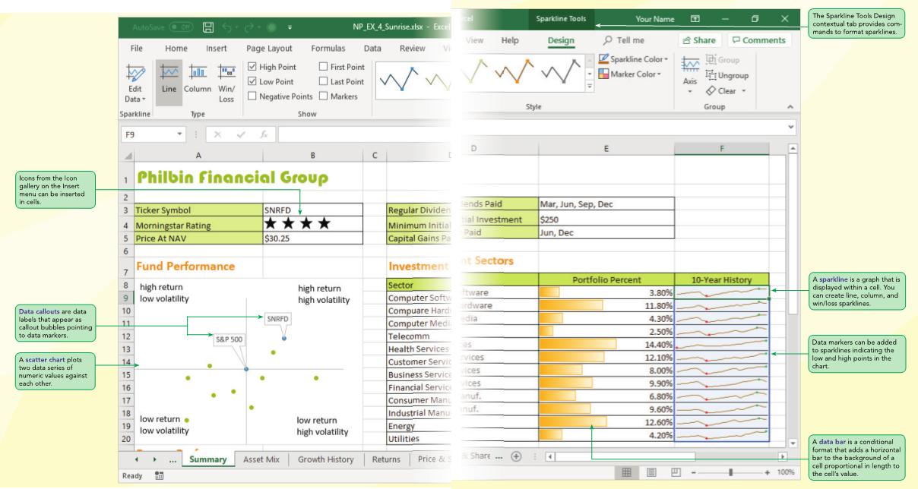
Visual Overview: Scatter Charts, Data Bars, and Sparklines

Slide 40
Creating a Scatter Chart, Part 1
A scatter chart plots two data series of numeric values against each other
Scatter charts are widely used in science and engineering applications when investigators want to discover how two numeric variables are related
Scatter charts comparing rates to volatility are usually centered at a point representing a balance between the two

Slide 41
Creating a Scatter Chart, Part 2

Slide 42
Editing the Chart Data Source, Part 1
To modify a Chart’s Data Source:
Click the chart to select it
On the Chart Tools Design tab, in the Data group, click the Select Data button
In the Legend Entries (Series) section click the Add button or the Remove button
Click the Edit button in the Horizontal (Category) Axis Labels section to select the category values for the chart

Slide 43
Editing a Chart Data Source, Part 2

Slide 44
Adding Graphic Objects to a Workbook, Part 1
Excel supports a large gallery of clip art and icons to supplement your charts and worksheet data
One graphic feature you can add to charts is a data callout
A callout is a label that appears as a text bubble attached to a data marker
Microsoft Office supports a gallery of over 160 shapes that can be added to any workbook or other Office document
The shape gallery includes rectangles, circles, arrows, stars, flow chart symbols, and text boxes
Each shape can be resized and formatted with a wide selection of colors, line styles, and special effects

Slide 45
Adding Graphic Objects to a Workbook, Part 2
Graphic icons, another type of graphic object supported by Microsoft Office, are common symbols often found in signs and posters
For precise placement of objects, Excel provides commands to align graphics within a row or column, distribute them evenly across a horizontal or vertical space, or stack graphics on top of each other
You can also group images together, creating new classes of graphic objects

Slide 46
Adding Graphic Objects to a Workbook, Part 3

Slide 47
Exploring Other Chart Types, Part 1
Hierarchical Charts
Hierarchy charts are like pie charts in that they show the relative contribution of groups to a whole
Unlike pie charts, a hierarchy chart also shows the organizational structure of the data with subcategories displayed within main categories
Excel supports two types of hierarchy charts: treemap charts and sunburst charts
Pareto Charts
A special kind of combination chart is the Pareto chart, which combines a column chart and a line chart to indicate which factors are the largest contributors to the whole

Slide 48
Exploring Other Chart Types, Part 2
Histogram Charts
A histogram is a column chart displaying the distribution of values from a single data series
Waterfall Charts
A waterfall chart tracks the addition and subtraction of values within a sum

Slide 49
Exploring Other Chart Types, Part 3

Slide 50
Creating Data Bars, Part 1
Conditional format that adds a horizontal bar to background of a cell containing a number
Length based on value of each cell in the range
Dynamic—the lengths of data bars automatically update if cell’s value changes
Modifying a Data Bar Rule
Modify by altering rules of the conditional format

Slide 51
Creating Data Bars, Part 2

Slide 52
Creating Sparklines, Part 1
A sparkline is a chart that is displayed entirely within a worksheet cell
Sparklines are compact in size; don’t include chart elements (legends, titles, or gridlines)
The goal of a sparkline is to convey the maximum amount of information within a very small space
Sparklines are useful when you don’t want charts to overwhelm the rest of your worksheet or take up valuable page space

Slide 53
Creating Sparklines, Part 2
You can create the following three types of sparklines:
A line sparkline for highlighting trends
A column sparkline for column charts
A win/loss sparkline for highlighting positive and negative values
Three types of sparklines:
Line sparkline: Highlights trends
Column sparkline: For column charts
Win/Loss sparkline: Highlights positive and negative values

Slide 54
Creating Sparklines, Part 3

Slide 55
Creating Sparklines, Part 4
Sparkline Groups and Sparkline Axes
You can change the scale of the vertical axis
The vertical axis will range from the minimum value to the maximum value
You can change the vertical axis scale to be the same for the related sparklines

Slide 56
Creating Sparklines, Part 5
Sparkline Groups and Sparkline Axes
The sparklines in the location range are part of a single group
Clicking any cell in the location range selects all of the sparklines in the group
Any formatting applied to one sparkline affects all of the sparklines in the group (ensures that the sparklines for related data are formatted consistently)
To format each sparkline differently, you must first ungroup them

